Slide 1
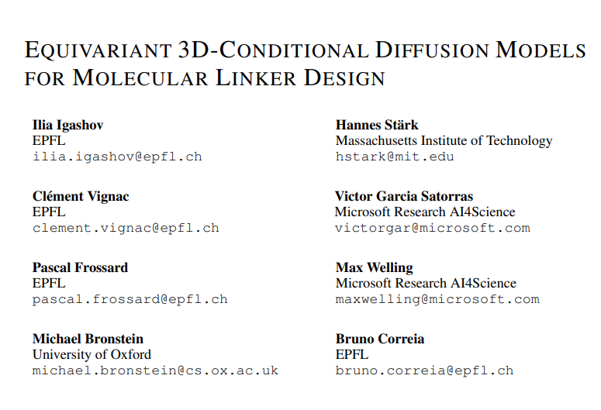
Arxiv October 2022

Slide 2
Abstract
… …Given a set of disconnected fragments, our model places missing atoms in between and designs a molecule incorporating all the initial fragments. Unlike previous approaches that are only able to connect pairs of molecular fragments, our method can link an arbitrary number of fragments. Additionally, the model automatically determines the number of atoms in the linker and its attachment points to the input fragments. We demonstrate that DiffLinker outperforms other methods on the standard datasets generating more diverse and synthetically-accessible molecules. Besides, we experimentally test our method in real-world applications, showing that it can successfully generate valid linkers conditioned on target protein pockets.

Slide 3
Task
1.以片段为基础组装分子
2.算法满足欧氏空间不变性(E(3)-equivariant)
输入模型的原子或者片段的坐标发生整体平移(translations)、旋转(rotations)或者映射(reflections)时，最后生成的效果都应该保持不变
3.与蛋白质口袋能够很好地匹配

Slide 4
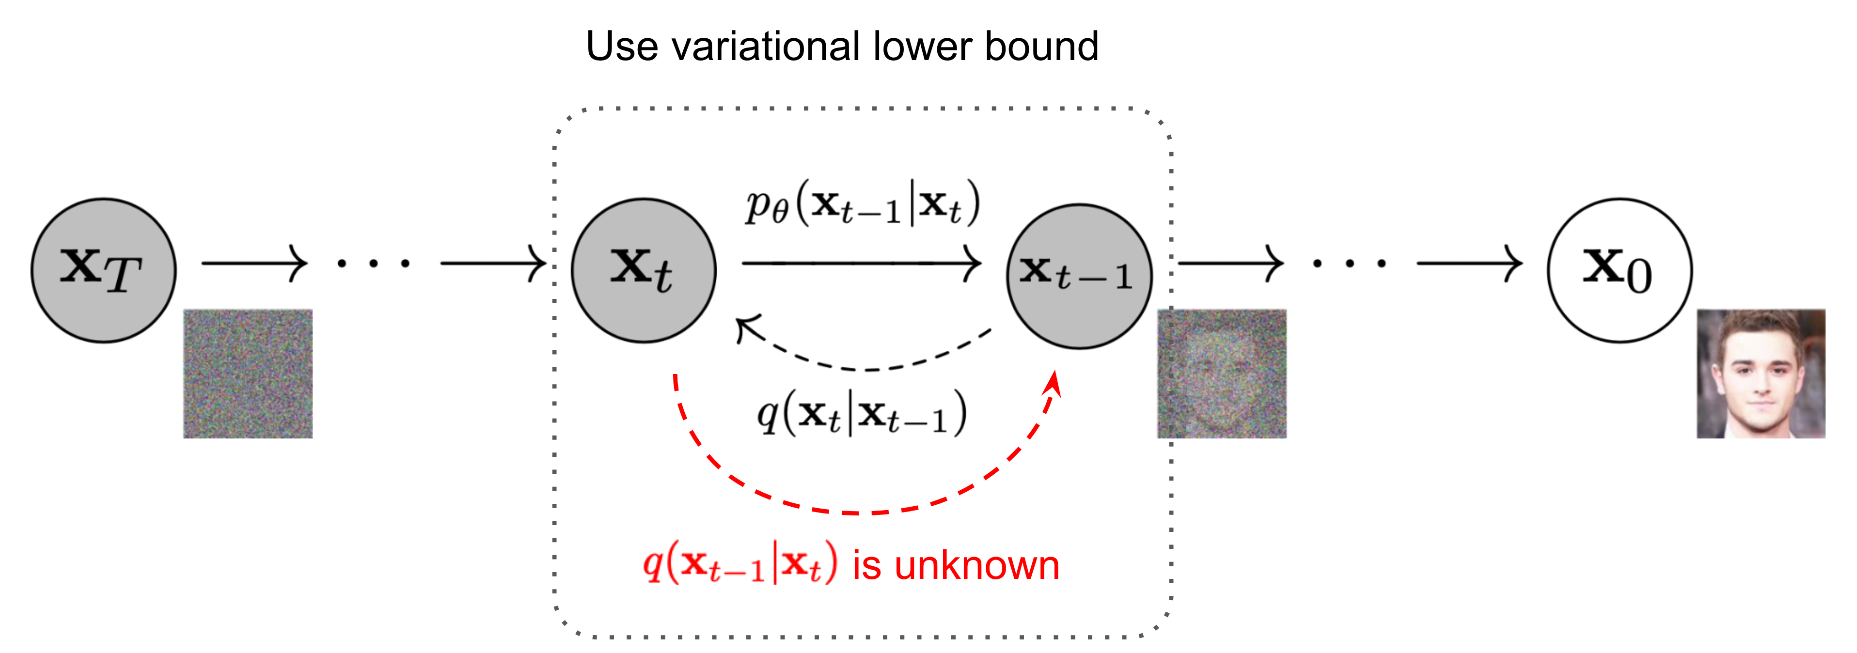


Diffusion model
Forward:
Reverse:
What are Diffusion Models?(https://lilianweng.github.io/posts/2021-07-11-diffusion-models/#forward-diffusion-process)

Slide 5



Diffusion model
Reverse:
Use neural network
simplify
What are Diffusion Models?(https://lilianweng.github.io/posts/2021-07-11-diffusion-models/#forward-diffusion-process)

Slide 6
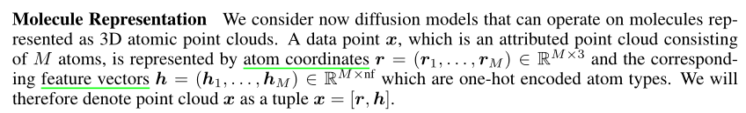
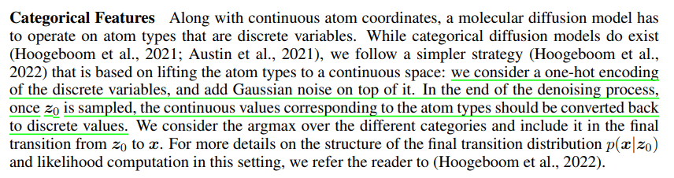
Diffusion for molecules
Molecule representation:
Categorical features:

Slide 7
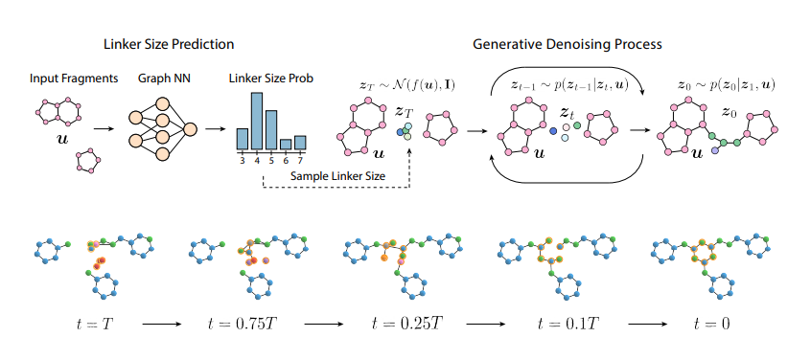
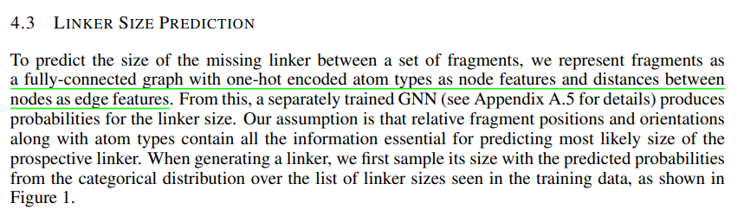

Slide 8
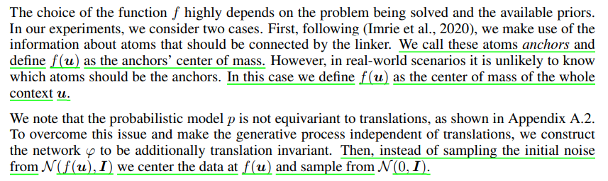

Slide 9
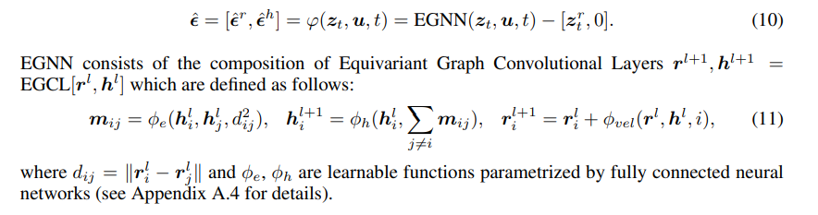

Slide 10
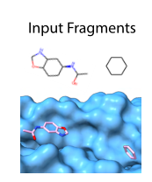
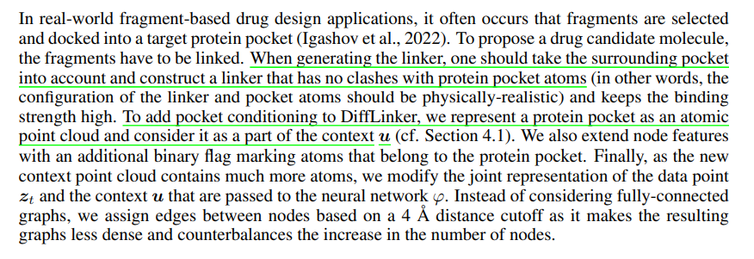
Protein pocket conditioning:

Slide 11
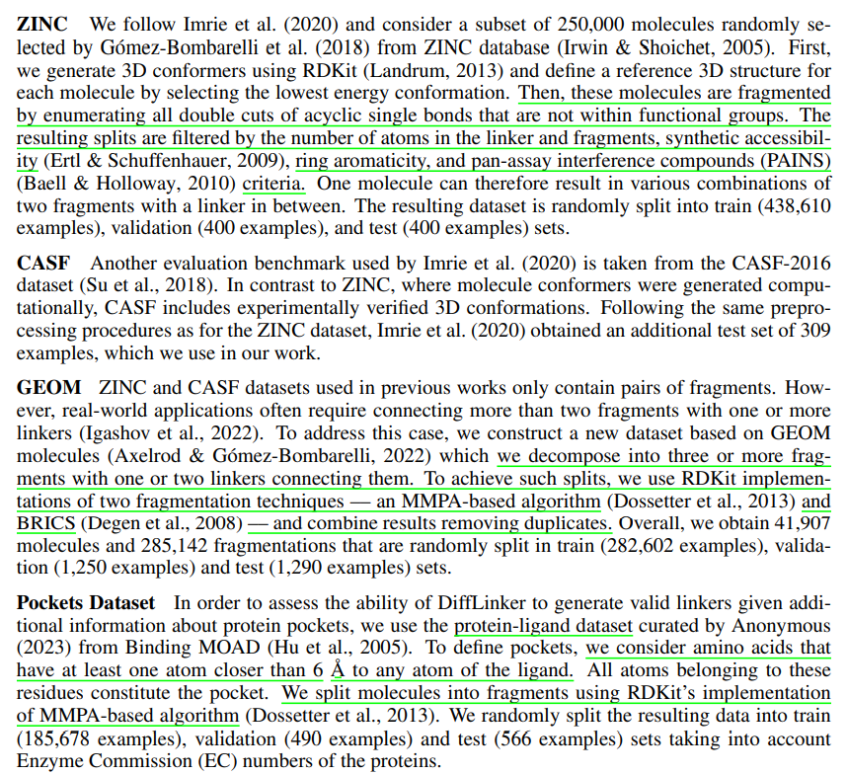
Datasets:

Slide 12
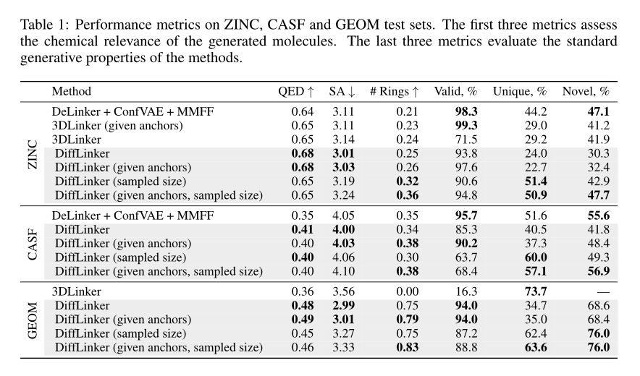
Results:

Slide 13
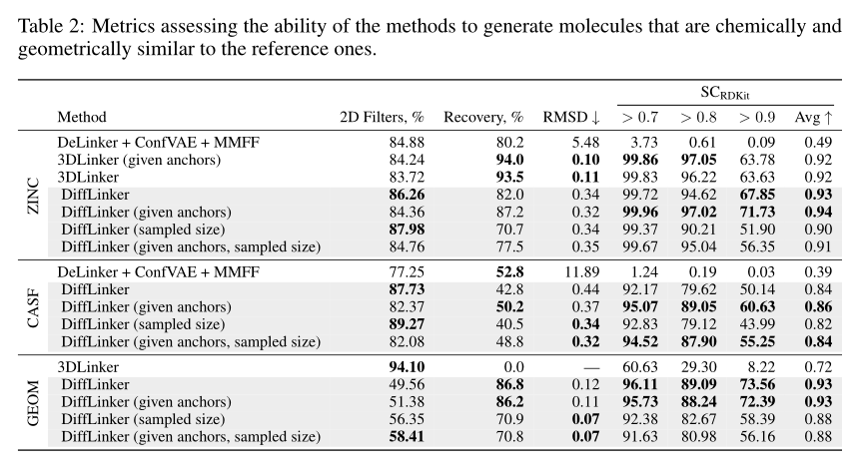
Results:

Slide 14
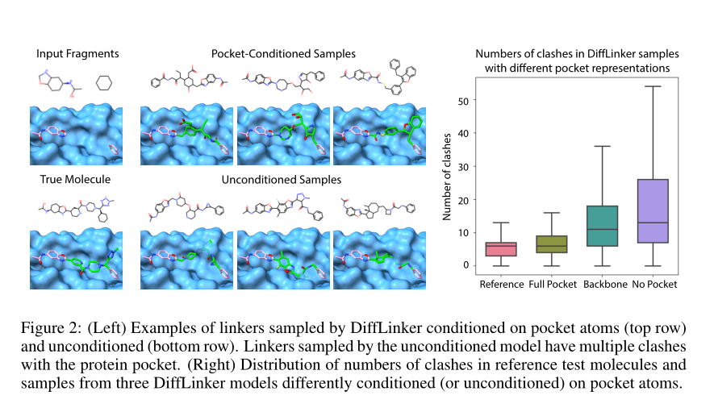
Results:

Slide 15
